Slide 1
Creating Client/Server Database App for Streaming Image File and Data Using NetBeans
©2020NorleyzaJailani

Slide 2
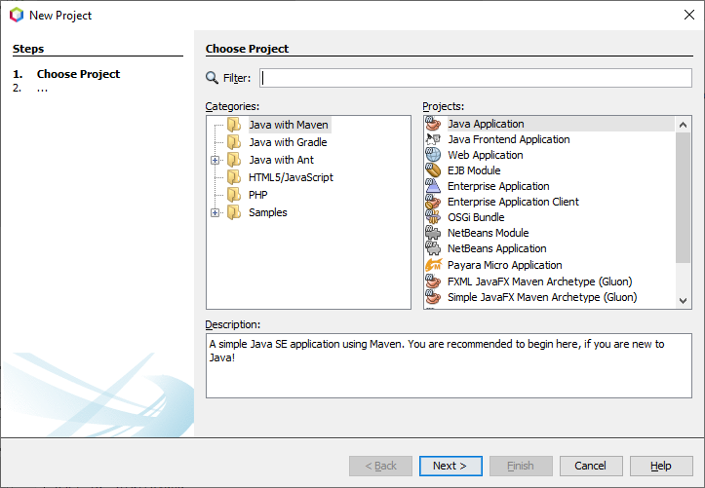
File>New Project Java with Maven, Java Application

Slide 3
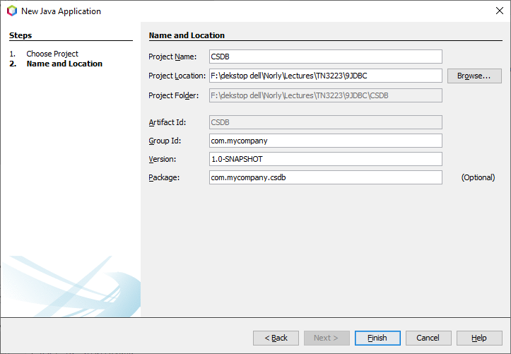
Input Project Name and Location

Slide 4
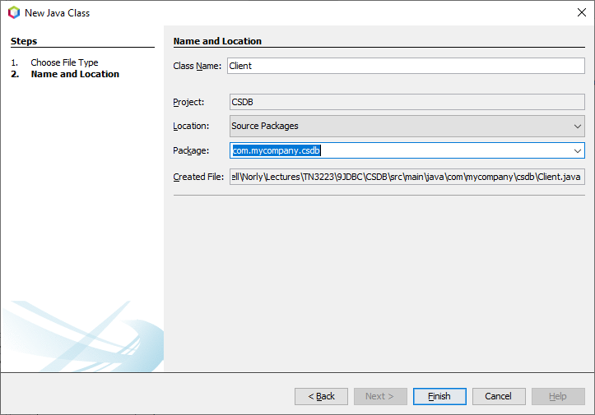
Create Client App Rightclick project name> new Java Class

Slide 5
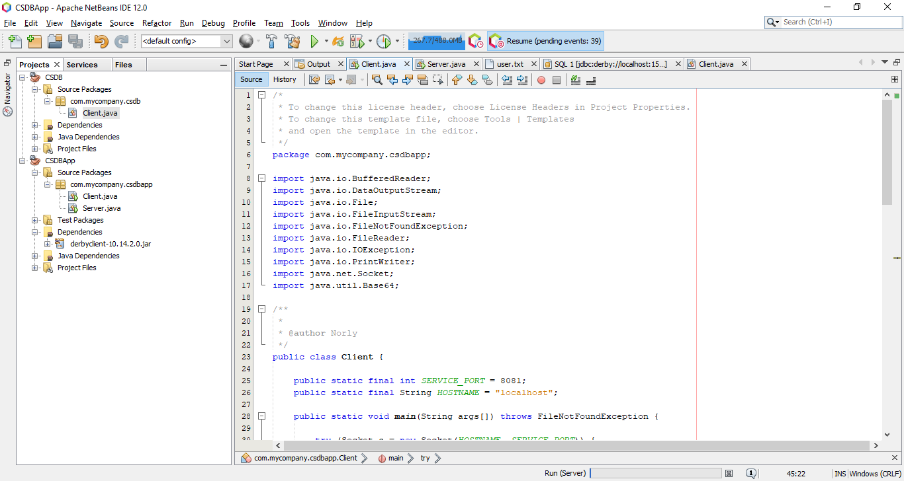
Copy content of Client.java

Slide 6
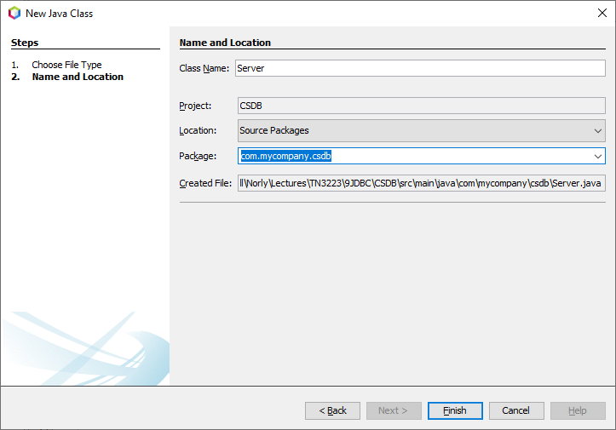
Create Server App Rightclick project name> new Java Class

Slide 7
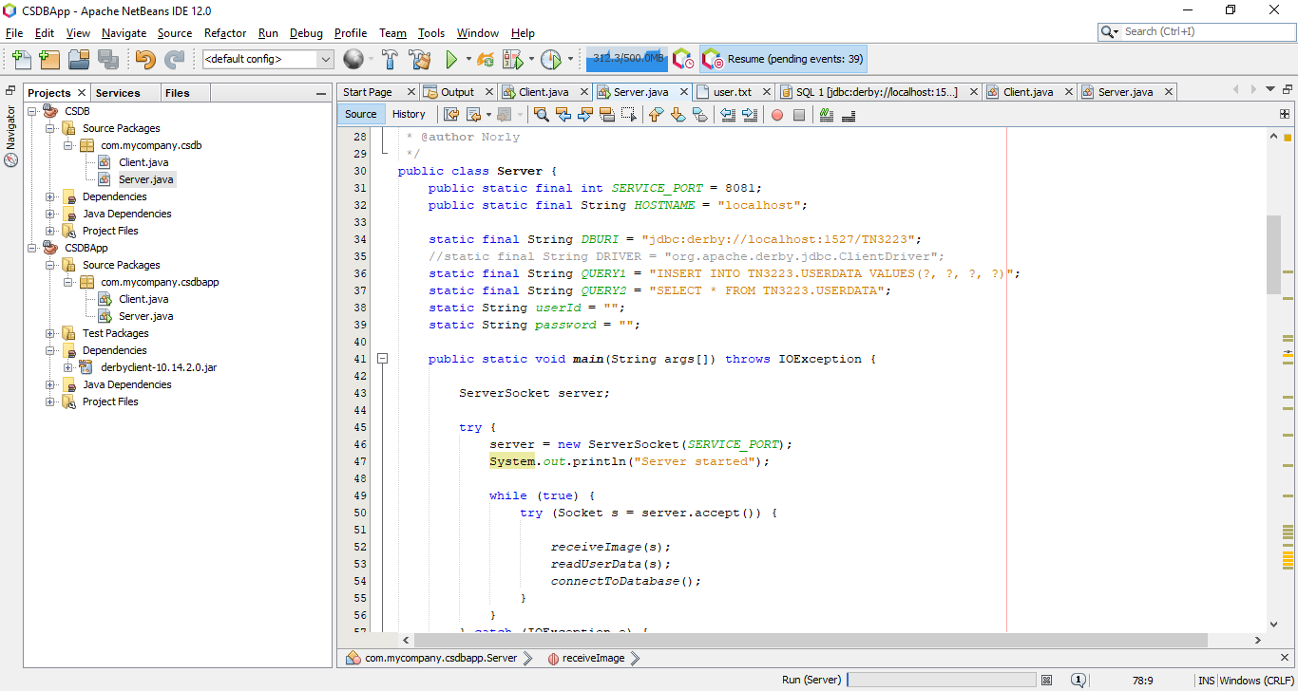
Copy content of Server.java

Slide 8
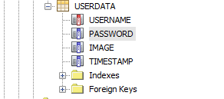
Select tab services>rightclick javadb>start server (to start db server) or create database (to create new db)
Remember username and password
Or use database you have created in Labtest1
Connect Database and Create Table as follows

Slide 9
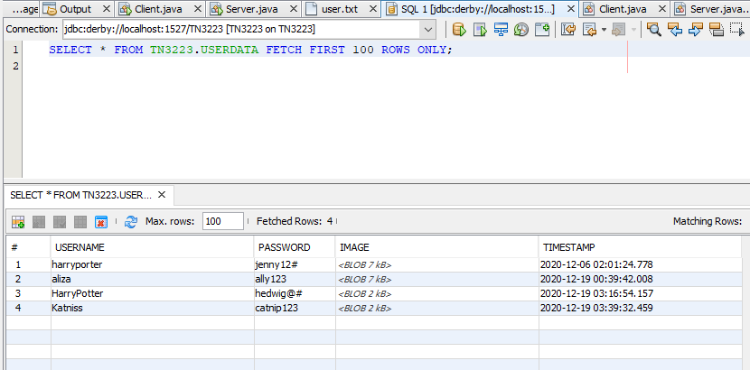
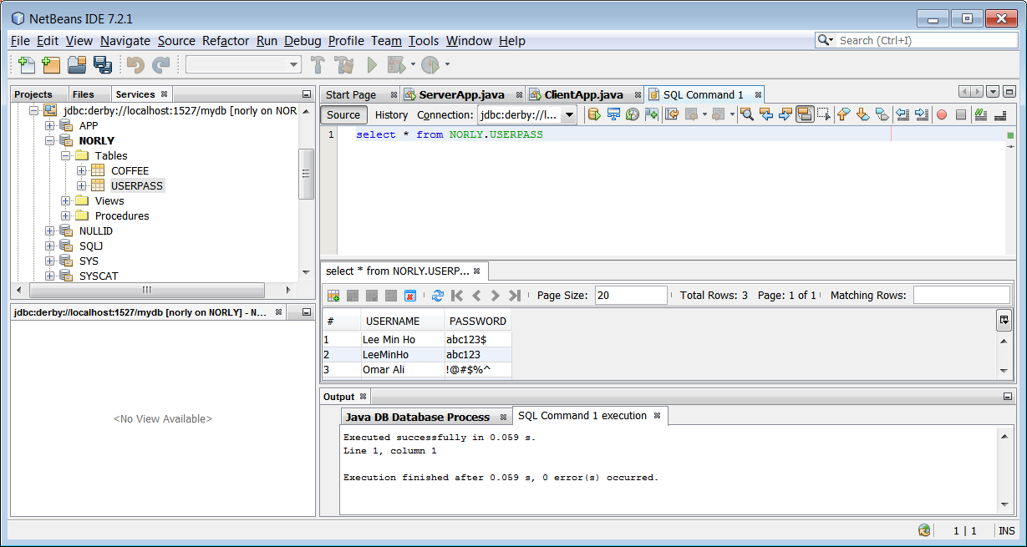
Rightclick table>view data

Slide 10
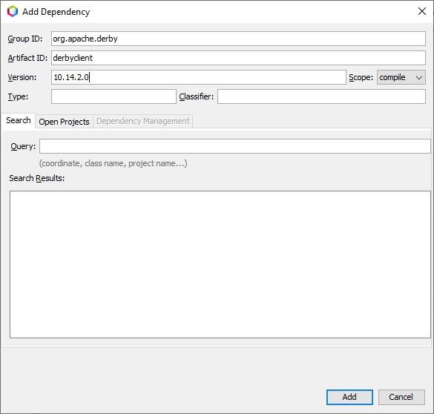
To link driver library: Add Dependencies as in previous lab

Slide 11
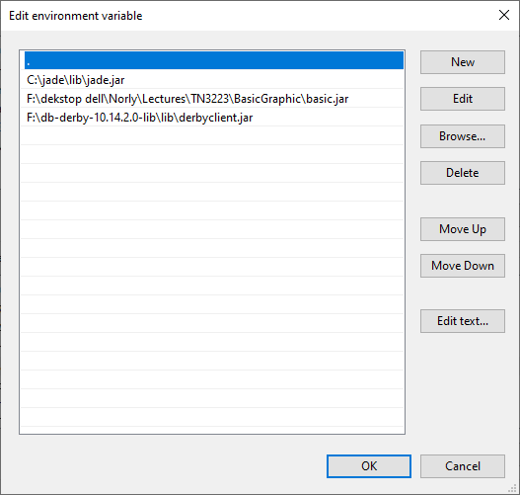
Assume you have set classpath to

Slide 12
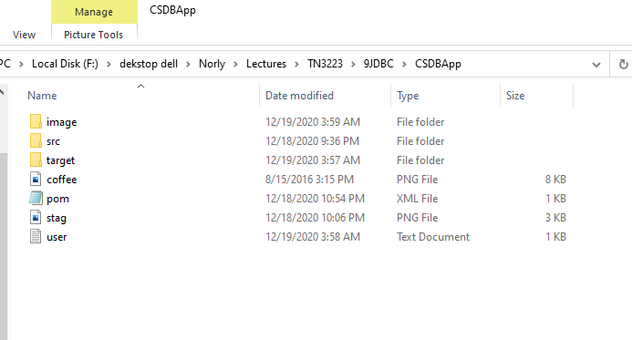
Client App will read from file user.txt
Copy file user.txt into Project folder
Copy file stag.png into Project folder
Create folder named image

Slide 13
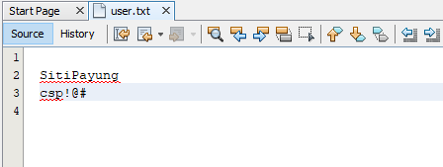
Leave the first line empty You may edit the username and password
The user.txt file is visible under tab Files

Slide 14
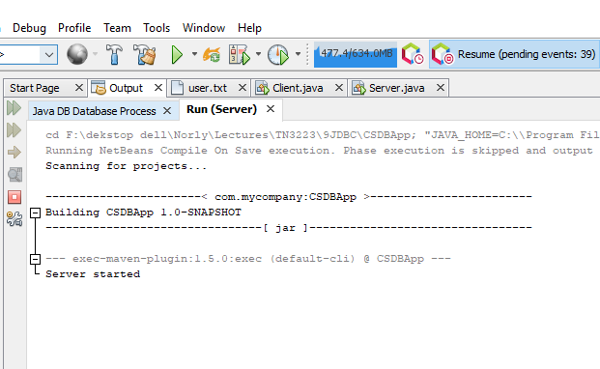
Rightclick project> Clean and Build
Right-click Server.java and Run File

Slide 15
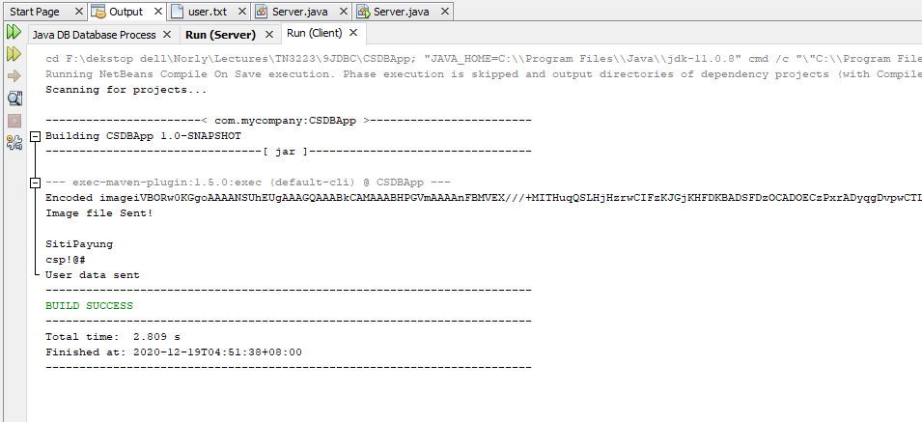
To run client: Rightclick Client.java>Run File
First, Client reads and sends image file. Image data encoded as string is displayed before being streamed to server
Second, Client reads user.txt, displays and sends the data as string to server

Slide 16
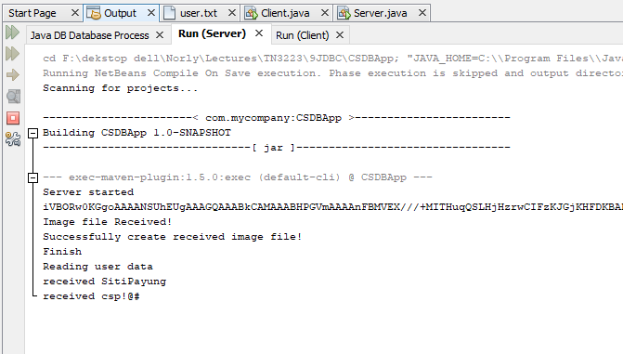
Output display at ServerApp
Image file received as encoded string will be decoded and written into a new file

Slide 17
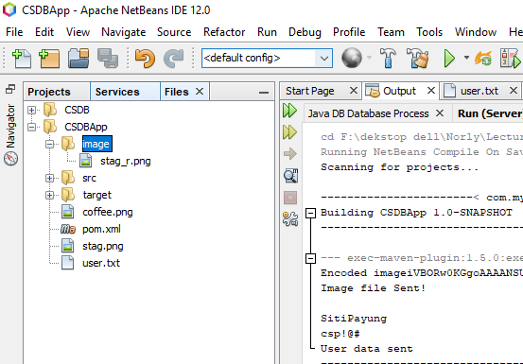
To run server app: Rightclick ServerApp.java>click Run File
Note: the server create an an image file (stag_r.png in the folder named image

Slide 18
Modify Server.java
Add statement to create timestamp
Modify query1 and add statement to insert timestamp
Uncomment the method connectToDatabase();
Clean and build project
Run Server, followed by Client

Slide 19
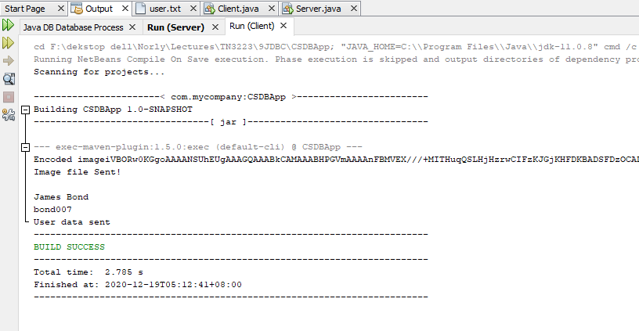
Client

Slide 20
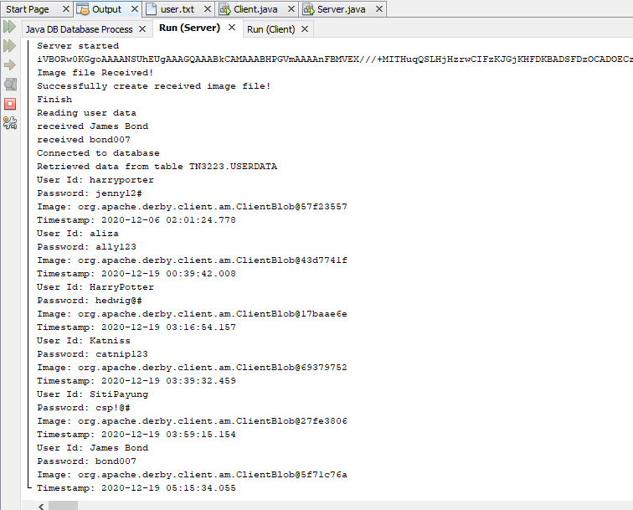
Server

